Slide 1
Emotion Recognition Using c++
Alisha Sultana
Athul S Nambiar
Shamila Mushthaque

Slide 2
Introduction
Emotion Recognition is the process of identifying human emotion, mostly from facial features.
Emotion Recognition
Machine Learning
Signal Processing
Computer Vision

Slide 3
Phases Involved in emotion recognition
Database Collection
Annotating Features
Training
Emotion Recognition
Get A Database
Manually Separate Images by Emotion
Detect Faces In Images
Generate Features Based On these Landmark
Write features to a file With Emotion Class
Train the features using a SVM
Use OVO or OVA for Multiclass Detection
Use Cross Validation to find Optimal Parameters for SVM
Generate an SVM Classifier and store it in disk for later use
Detect Face
Align Landmark Points and Generate Features
Pass the features to the Classifier and Detect Emotion
Align Landmark Points on the Detected Faces
There are 1400 happy,1045 neutral, 444 sad and 490 Surprise images

Slide 4
Database Collection
Get a Database
Manually Separate Images by Emotion
The database we used was Cohn-Kanade Database
This database contains Image sequences in which the subjects emotion changes from A neutral expression to a peak expression
We used 4 Emotions For this project (Neutral, Happy, Sad, Surprise)
The Neutral images from Starting of the Sequence were removed
Then each emotion was Put into separate Folders

Slide 5
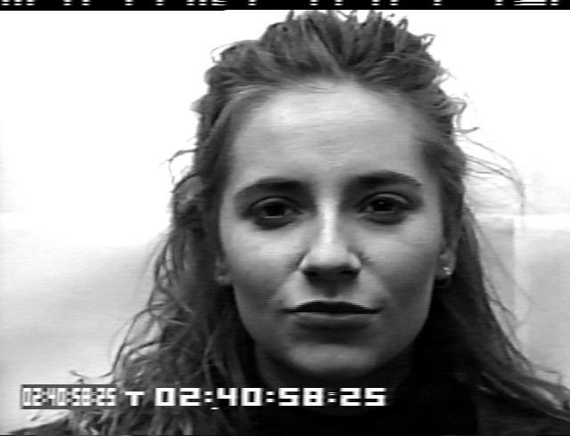
Happy

Slide 6

Happy

Slide 7

Happy

Slide 8

Happy

Slide 9

Happy

Slide 10
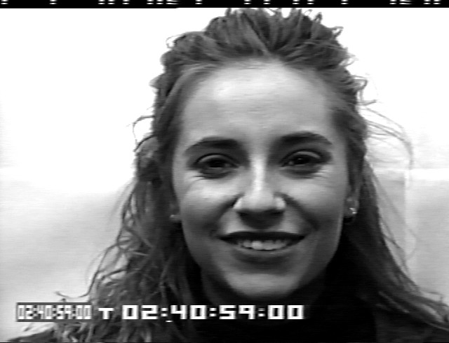
Happy

Slide 11
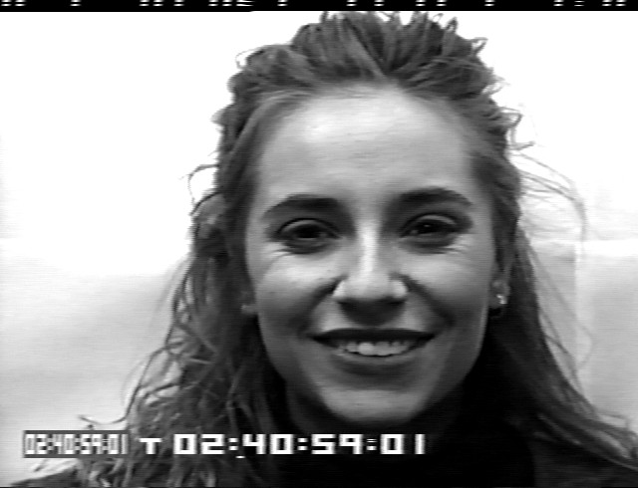
Happy

Slide 12
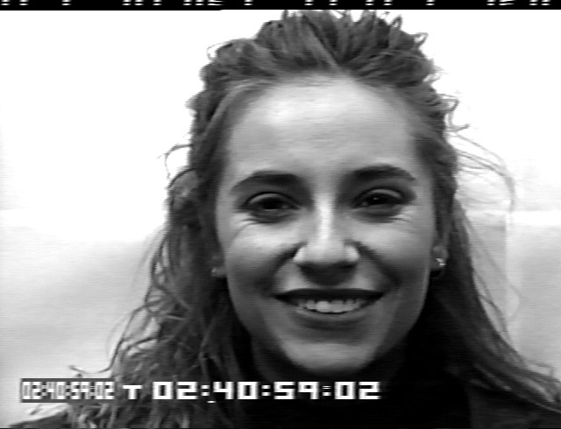
Happy

Slide 13

Happy

Slide 14
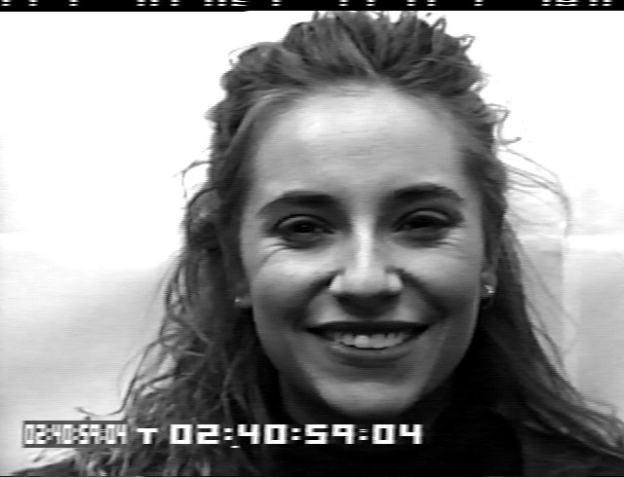
Happy

Slide 15
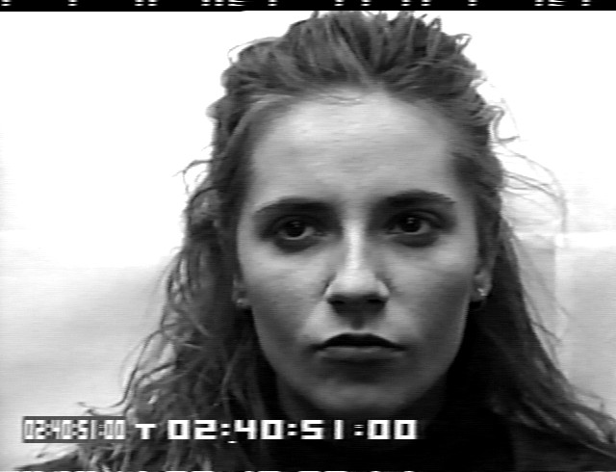
Neutral

Slide 16

Neutral

Slide 17

Neutral

Slide 18

Neutral

Slide 19

Neutral

Slide 20
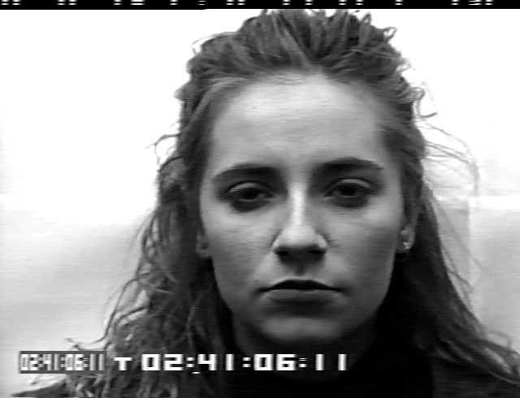
Neutral

Slide 21

Neutral

Slide 22

Neutral

Slide 23
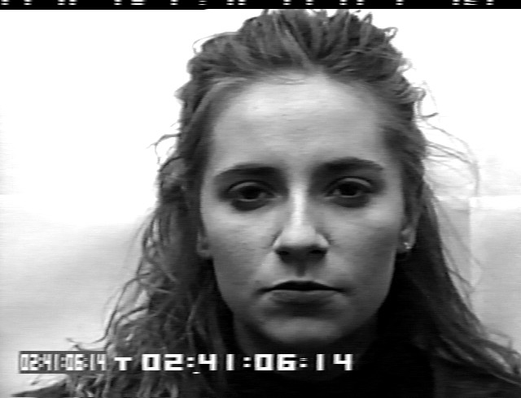
Neutral

Slide 24
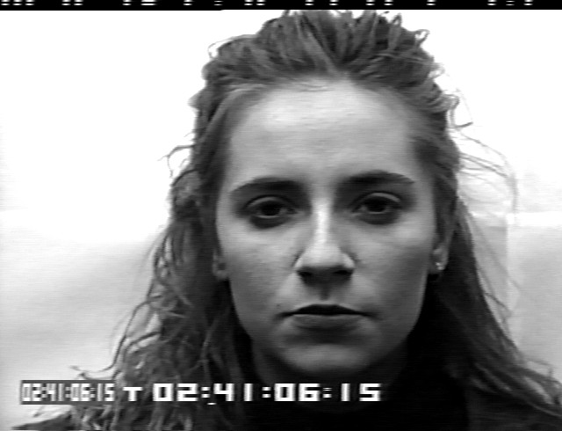
Neutral

Slide 25
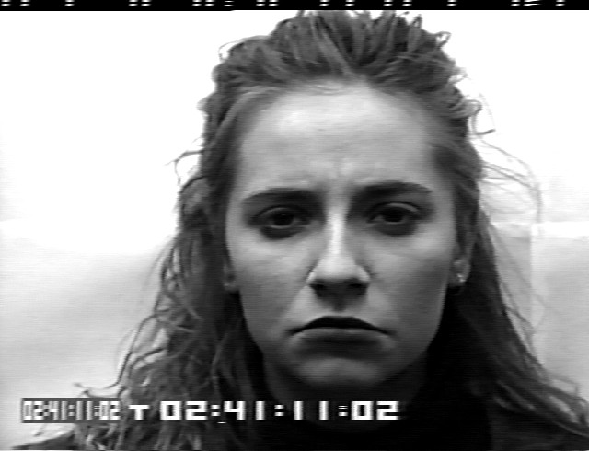
Sad

Slide 26
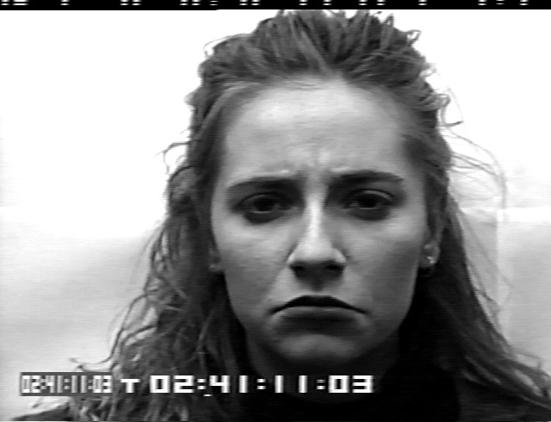
Sad

Slide 27
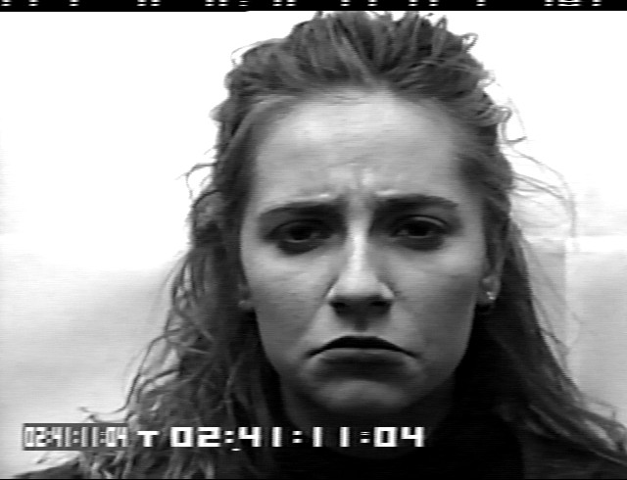
Sad

Slide 28
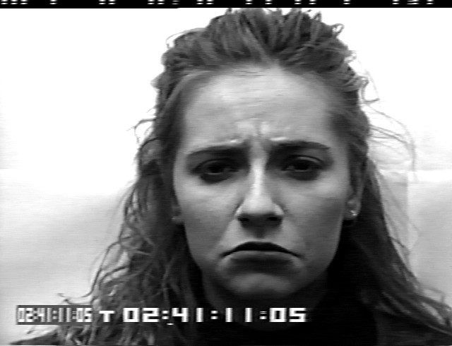
Sad

Slide 29

Sad

Slide 30
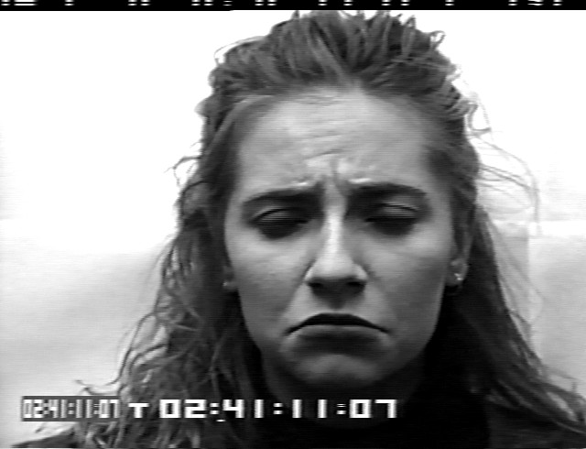
Sad

Slide 31

Sad

Slide 32
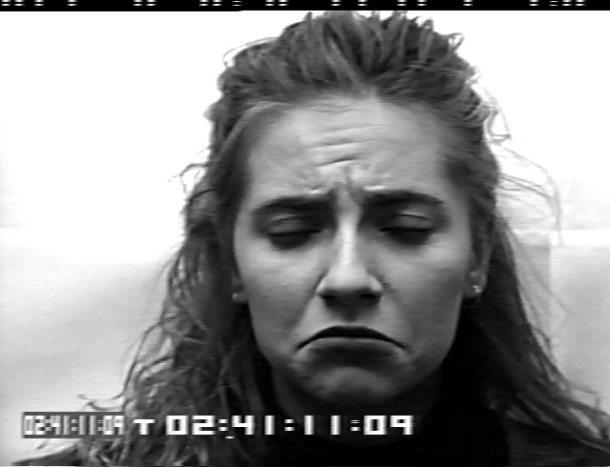
Sad

Slide 33
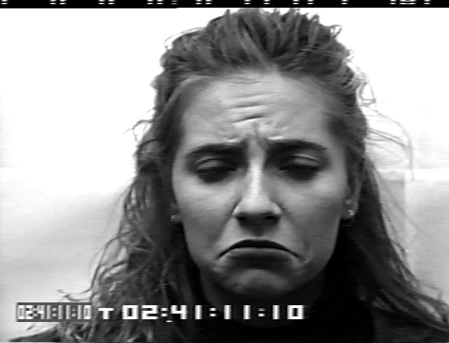
Sad

Slide 34

Sad

Slide 35

Sad

Slide 36

Sad

Slide 37
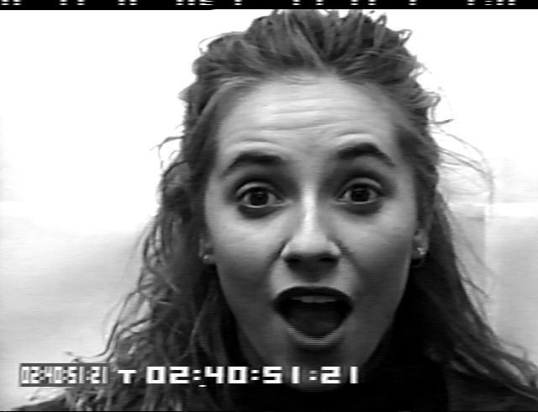
Surprise

Slide 38

Surprise

Slide 39
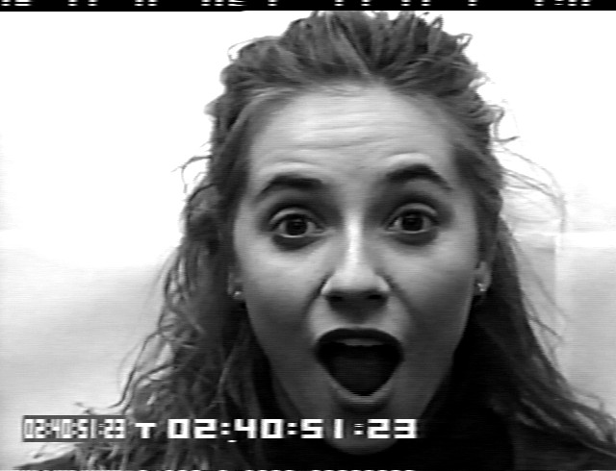
Surprise

Slide 40

Surprise

Slide 41

Surprise

Slide 42
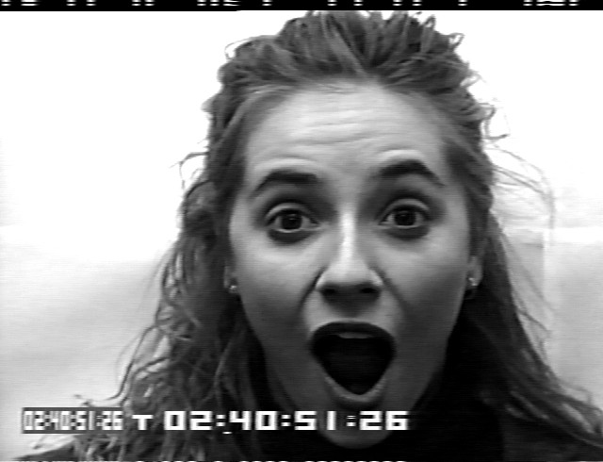
Surprise

Slide 43

Surprise

Slide 44

Surprise

Slide 45
Annotating Features
Detect Faces In Images
Align Landmark Points on the Detected Faces
Generate Features Based On these Landmark
Write features to a file With Emotion Class
Faces are Detected using HOG features implementation in dlib
The cropped face from previous stage is read
Landmark Alignment is performed on these images
These properly oriented cropped faces are then written to disk
Using landmark Points the face orientation is corrected
Then Face Detection is applied again to detect faces.
Finally Landmark Alignment is applied
This is done because of chances of false positives in previous step
There are total 68 Landmark points
The length and slope of line segment from every point to every other point is used as feature
Therefore there are 4556 features for a single face
These features are then written to disk as CSV file
There are 4557 columns in this file
4556 features + 1 Emotion
Feature of each image is added twice to the CSV to increase the strength of Classifier

Slide 46
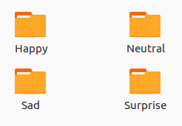
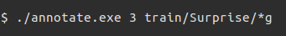



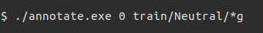

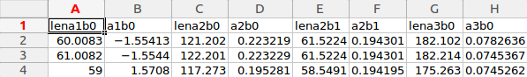
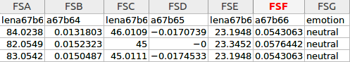
Annotating Features

Slide 47
Training
Train the features using a SVM
Use OVO or OVA for Multiclass Detection
Use Cross Validation to find Optimal Parameters for SVM
Generate a SVM Classifier and store it in disk for later use
SVM was used because is computationally less demanding than ANN and LR
Both OVA and OVO were implemented
OVA : Easier to get the Probability values corresponding to each Emotion
OVO : Less effected by problems of imbalanced datasets but computationally expensive
3 – Fold cross validation was applied to find optimal parameters
Optimal parameters nu = 0.0498789 & gamma = 1.4641e-05
After Training the classifier is stored to disk
For training Data was read from the CSV file
Columns were separated to Features and labels
Rows were randomized and Columns of features normalized
In case of OVO there are 6 Classifiers
Where as OVA has 4 Classifiers

Slide 48
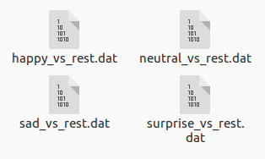
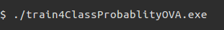
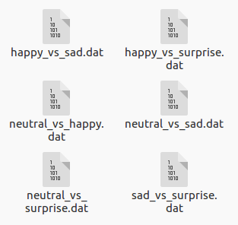
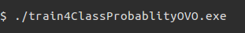
Training

Slide 49
Emotion Recognition
Detect Face
Align Landmark Points and Generate Features
Pass the features to the Classifier and Detect Emotion
Faces are Detected And Re-checked in same way as annotation
All the faces in a given image are Cropped And written to disk and numbered
Features are generated from each image and stored in a vector
Land marking id done in same way as annotation
The faces are classified for emotions using Classifier
Probabilities are calculated for each of the emotions and displayed

Slide 50
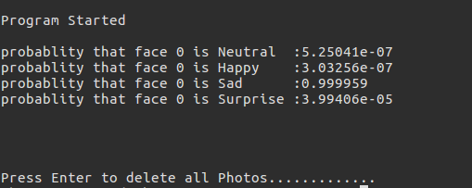
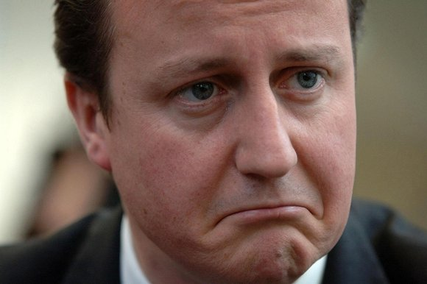
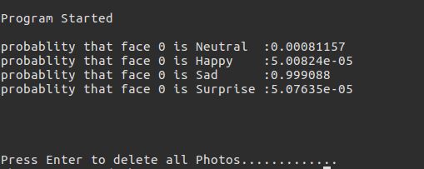
Emotion Recognition

Slide 51
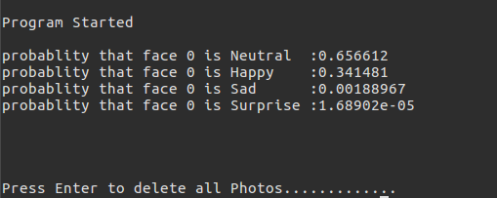

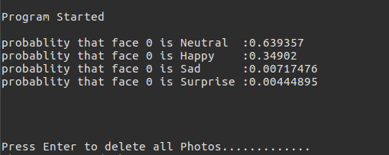
Emotion Recognition

